Slide 1



Tally.ERP9
LANDED COST MODULE
Presented by :
EE Software Technologies Pvt. Ltd.
Copyright © 2013

Slide 2
Landed Cost – its need
Landed Cost is the total cost of a product including all the overhead expenses such as brokerage, logistics fees, complete shipping costs, customs duties, tariffs, taxes, insurance, currency conversion, crating costs, and handling fees on arrival of goods. Not all of these components are present in every shipment to be accounted for to arrive at the landed cost of each product; however, one has to account the entire overheads mentioned as above to arrive at the landed cost, which is a significant task under the current systems.
Additionally, User has to account every cost in to system as and when he gets to know them, which ends up in significant man power consumption, recording multiple transactions for each cost etc., to arrive at this single cost, there by compromising on the size of the data and performance issues.
Currently not all the systems are capable / designed to arrive at the Landed cost of the products, so the need has been raised to design a system which helps in arriving at Landed cost of the product without comprising on any of the above mentioned factors.
Presented by :
EE Software Technologies Pvt. Ltd.
Copyright © 2013

Slide 3
About - Landed Cost Module
Faced with the challenges of minimizing man power consumption, passing minimal entries to record all the costs, minimizing the data size and provide considerable speed etc., We have understood the need for arriving at the landed cost of each product.
Our Landed cost module helps account all the overhead costs of the Items in one single transaction, thereby helps minimize the human resource consumption, records all the overheads in single transaction which minimizes the no of entries to be passed, thus minimizing the data size which results in improved performance of the application/system, all in one single entry.
As opposed to the general methods of arriving at costing based on value, Landed Cost Module thereby allows you appropriate costing both, by the quantity of a given product or value of your choice. It helps you arrive effortlessly at Landed Cost of products by easing cost calculation considerably.
Please find the modus operandi of the functioning detailed hereunder
Presented by :
EE Software Technologies Pvt. Ltd.
Copyright © 2013

Slide 4
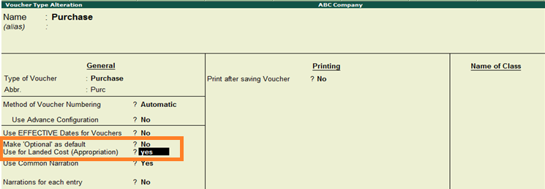
Altering Purchase Voucher Type
Go to Gateway of Tally > Accounts Info/ Inventory Info >
Voucher Type > Alter and select Voucher Type” Purchase”
The Voucher type Alteration screen is displayed as below in alter mode:
Set Use for Landed Cost (Appropriation) to “Yes” as highlighted in the
Below screen
Presented by :
EE Software Technologies Pvt. Ltd.
Copyright © 2013

Slide 5
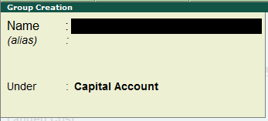
Creating a Group
Go to Gateway of Tally > Accounts Info. > Groups >
Single Group click Create
Group creation is displayed as below
Name of Group : Enter the name of the Group to be created, say “Import Charges” in the name field.
Under : Select the existing (Parent) group “Direct expenses”.
Presented by :
EE Software Technologies Pvt. Ltd.
Copyright © 2013

Slide 6
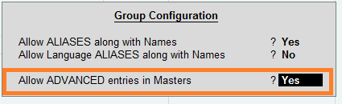
Creating a Group - (contd)
With in the Group creation screen, Press F12 Configure button/key and
set Allow Advanced entries in Masters to “Yes” as shown in below
screen and accept the same.
Presented by :
EE Software Technologies Pvt. Ltd.
Copyright © 2013

Slide 7
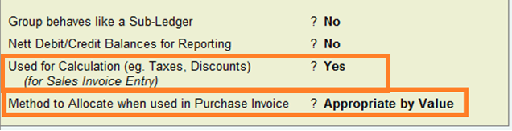
Creating a Group - (contd)
Set Used for Calculation (eg. Taxes, Discounts) to “Yes”.
And Method to allocate when used in Purchase Invoice to be
Appropriate by Value as shown below
Note : Please do not change the Method to allocate when used in Purchase Invoice in between once the same is set to either “Appropriate by Value” or “Appropriate by Cost” . Changing the values in between may adverse the calculations.
Presented by :
EE Software Technologies Pvt. Ltd.
Copyright © 2013

Slide 8
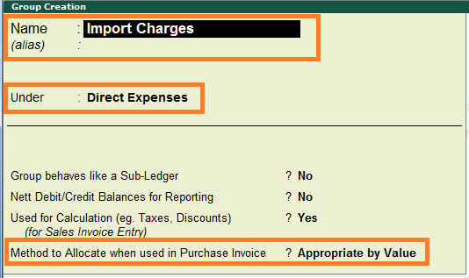
Creating a Group - (contd)
The Group Creation screen is displayed as below after the above updates:
Presented by :
EE Software Technologies Pvt. Ltd.
Copyright © 2013

Slide 9
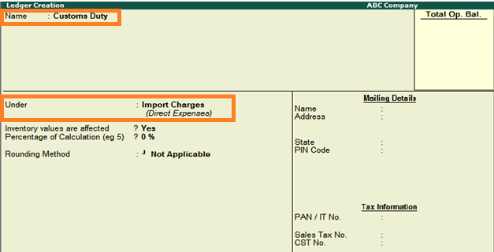
Creating a ledger
Go to Gateway of Tally > Accounts Info. > Ledgers >
Single Ledger click Create
Name : Enter the Name of the Ledger say Customs Duty
Under : Select the existing (Parent) group “Import Charges”.
The Ledger Creation screen is displayed as shown:
Note : We can create all relevant ledgers (overhead expenses like : duties,
taxes, freight, insurance, etc) as much as we need under the same group.
Presented by :
EE Software Technologies Pvt. Ltd.
Copyright © 2013

Slide 10
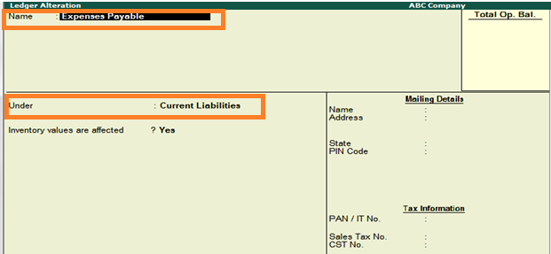
Creating a Expense Payable Ledger
We need to create the payable ledger under Current liabilities/ Sundry
Creditors for allocating all the expenses,. The payable ledger can either
be Freight/ Expenses Payable etc or we can credit to vendor (sundry
creditors) directly incase if the bills are received.
The Expense Payable Ledger Creation screen is displayed as shown:
Presented by :
EE Software Technologies Pvt. Ltd.
Copyright © 2013

Slide 11
Creating a Expense Payable Ledger – (contd)
After booking the Overhead expenses, we have to pass the necessary
reversal entry of the same under Current liabilities to ensure
completion of voucher in the same screen/ voucher below.
Presented by :
EE Software Technologies Pvt. Ltd.
Copyright © 2013

Slide 12
Voucher Entry - Purchase
Go to Gateway of Tally > Accounting Vouchers and Click on
F9: Purchase on the Button Bar or press F9.
The Purchase Entry screen is displayed as below:
Select the inventory items and usual, then select the over head expenses
(Freight, Custom duty, Clearance, Insurance etc) under Landed Cost
Allocations as shown in the next slide:
Presented by :
EE Software Technologies Pvt. Ltd.
Copyright © 2013

Slide 13
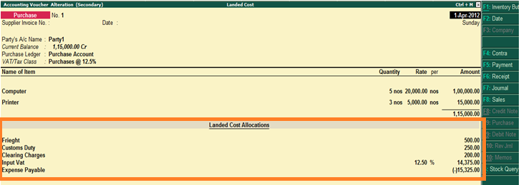
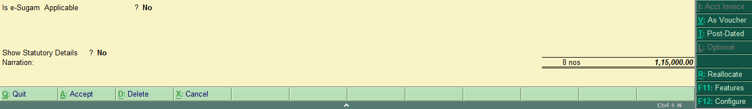
Voucher Entry- Purchase - (contd)
Presented by :
EE Software Technologies Pvt. Ltd.
Copyright © 2013

Slide 14
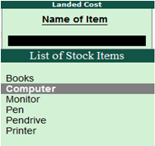
Final Product Cost (Landed Cost)
After passing the purchase entry, we can check the cost of products from
closing stock / stock summary as below. Here we can see the Landed
Cost rate for each item appropriately added by its value.
Go to Gateway of Tally -> Display - > Inventory Books ->
Movement Analysis -> Stock Item Analysis
Presented by :
EE Software Technologies Pvt. Ltd.
Copyright © 2013

Slide 15
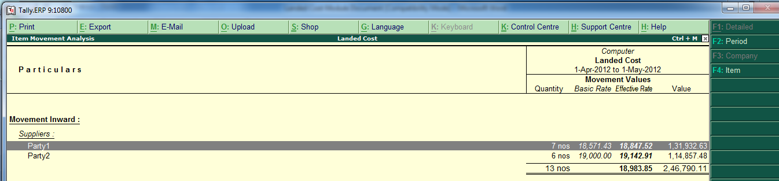
Final Product Cost (Landed Cost) – (contd)
Select (Eg: Computer) & press Enter - below screen is displayed :
Presented by :
EE Software Technologies Pvt. Ltd.
Copyright © 2013

Slide 16
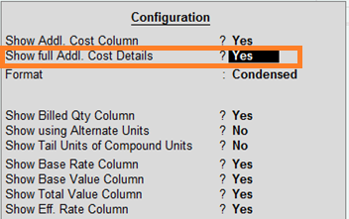
Final Product Cost (Landed Cost) - Party wise
If the User prefers to view the report Party wise, then Press Enter on
the selected party. If the user intends to view the detailed report of
overhead Expenses freight, customs duty etc, then Press F12 and
select the option show full Addl. cost details to YES as shown below.
Presented by :
EE Software Technologies Pvt. Ltd.
Copyright © 2013

Slide 17
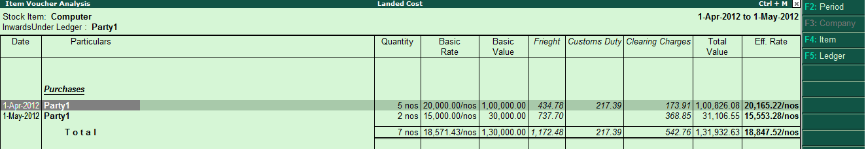
Final Product Cost (Landed Cost) - Party wise (contd)
Party wise Landed cost details are shown along with overhead costs as
below:
Note : This report can also be viewed for a particular item by pressing F4 button and for a particular party by pressing F5 button and selecting the same.
Presented by :
EE Software Technologies Pvt. Ltd.
Copyright © 2013

Slide 18
Thank you
Presented by :
EE Software Technologies Pvt. Ltd.
# 447/A, 17th G Main, 6th Block
Koramangala, Bangalore - 560 095, INDIA
Ph: +91 80 4113 1825 / 99000 36881 / 93425 37577
enterprise@eestpl.com
www.eestpl.com

